Slide 2
Office 365 OneDrive video sharing
Uploading videos and Diploma production registration

Slide 3
Technical requirements for video recordings
Only those recordings will be considered eligible and possible to assess which meet the technical requirements. Sound recordings only and videos of different formats will be rejected.
The submitted performance video has to be recorded in a way that the student uploading the video and the performance itself is possible to authenticate.
The video recording may only contain uncut recording of the performance, the pieces/movements have to be continuous without any cuts. Any post-work done in any shape or form (sound or picture) or with the usage of any kind of technology, is prohibited.
The picture of the video recording has to be done considering the following:
The format of the shot has to be horizontal (landscape).
The student has to be in the middle of the picture with a clear and visible shot of their face and hands in focus.
Avoid backlight (the main source of light is preferably behind the camera, in front of the student).
The sound quality of the recording has to be good enough so that instrument is clear, easily separated from outside and technical noises during the entirety of the performance.
File-format: mp4.

Slide 4
Length of recordings and uploading
Length of video recording for BA students: 30 minutes
Length of video recording for MA students: 45 minutes at minimum, 60 minutes at maximum
The video recording should be uploaded to Office 365 OneDrive and shared with the Academy. Technical information for using Office 365 OneDrive is available in this guide. The submitted performance video has to be recorded in a way that the student uploading the video and the performance itself is possible to authenticate. Only those recordings will be considered eligible and possible to assess which meet the technical requirements, which can be found in the guide and section I. above.
We ask you to check the shared video before submitting it. The shared video should be available at least until 5 June 2021. The video should not be modified after it has been uploaded and shared.
The Academy has the right to verify the above-mentioned details. The technical quality of the video recording does not affect assessment.
We are kindly asking our students to act in accordance with the current epidemic related guidelines and preventative measures during the preparation of the video recording. This is everyone’s personal responsibility.

Slide 5
Deadlines
Uploading the video recordings for both BA and MA students will be possible during the following period: from 5 May 2021, 00.00, until 25 May 2021, 24.00.

Slide 6
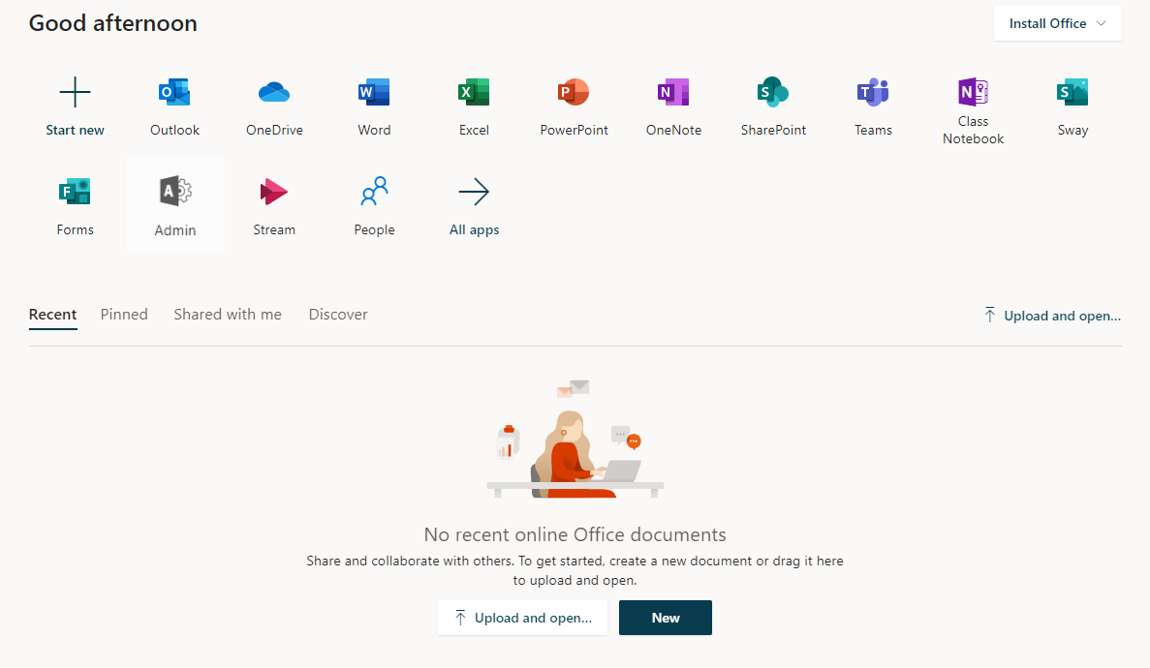
Log in at www.office.com with the given e-mail address and password! (check the e-mail from 9 April, or 7 September about login information for Office 365)
Username: <neptuncode>@student.lfze.hu
If you forgot your password, send an e-mail to itsupport.vizsga@zeneakademia.hu .
Click on the OneDrive button after logging in.

Slide 7
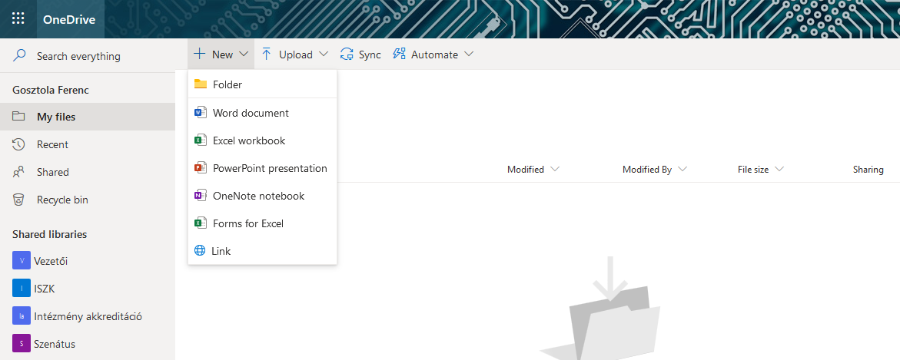
Create a folder to store your shared documents in.
Click on „New” > „Folder” to create the folder.

Slide 8
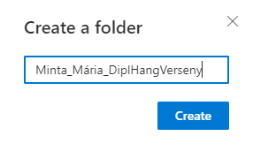
Give the folder a name. The folder name should start with the student’s name (eg. Smith_John). After choosing the folder name, click on „Create”.

Slide 9
Click on the folder name to open the folder. Now you can upload the exam recording in this folder.

Slide 10
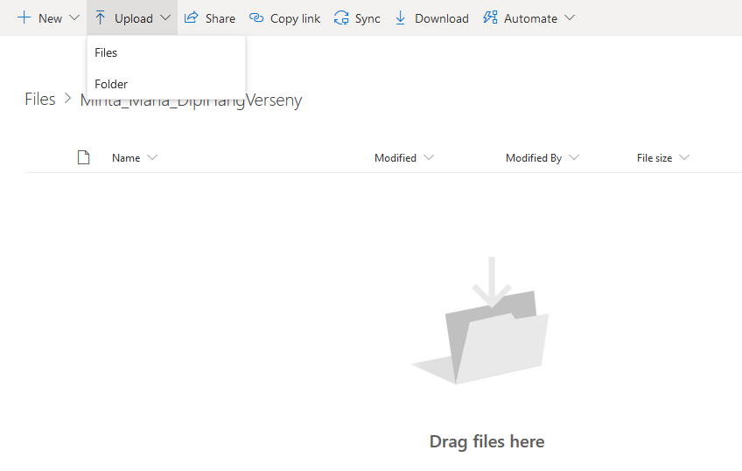
Click on „Upload” > „Files”.
Choose the files you want to upload, then click on „Open”. The uploading will start.
Please give the uploaded file an appropriate name. The file name should start with the student’s name (eg. Smith_John_exam_video).

Slide 11
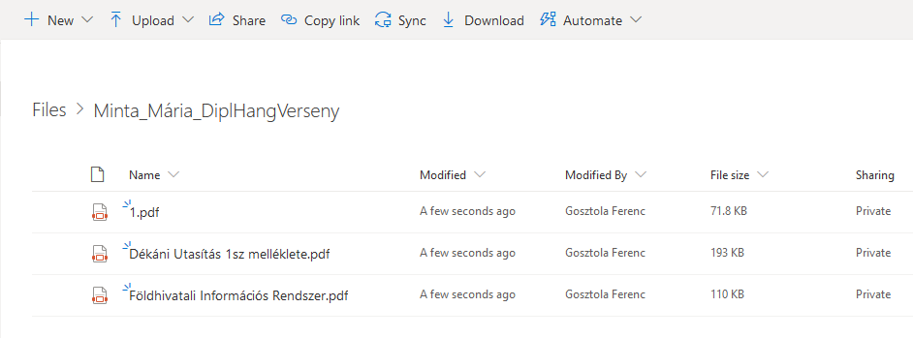
After uploading the file, click on „Files” to go back to the main page where you can share the folder.

Slide 12
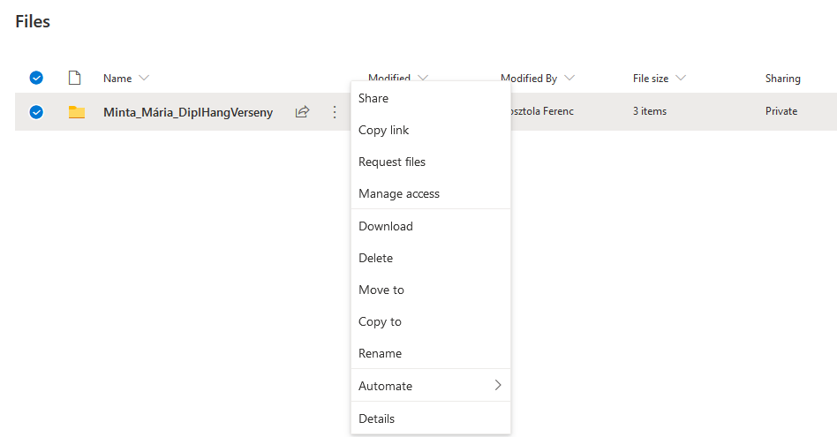
To share the folder, click on the vertical dots („…”) > „Share”.

Slide 13
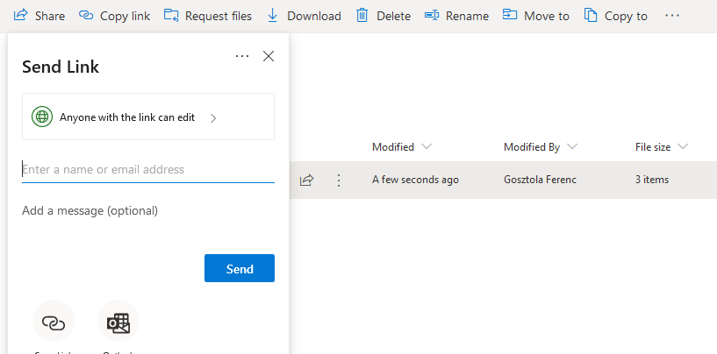
To change sharing settings, click on the green globe icon.

Slide 14
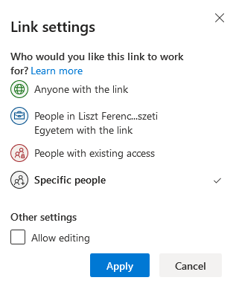
Choose „Anyone with the link” and do NOT tick „Allow editing”.
Click on „Apply”.

Slide 15
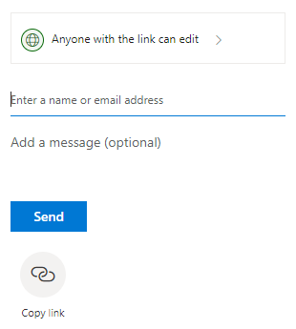
Click the „Copy link” button to share.

Slide 16
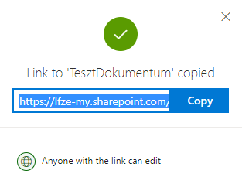
Click the „Copy” button.
After clicking the "Copy" button, you have a link to the video. From now on, you can share the link anywhere by "pasting". (right mouse button, paste) (Ctrl + V)

Slide 17
Filling the diploma production form

Slide 18
Click the link below to complete the form.
https://ecv.microsoft.com/qHwIsumZsF

Slide 19
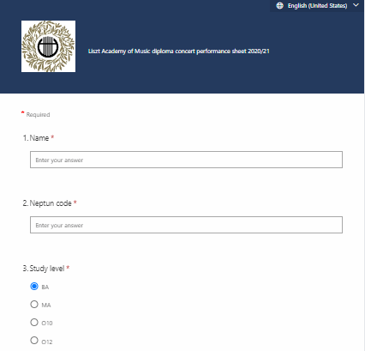
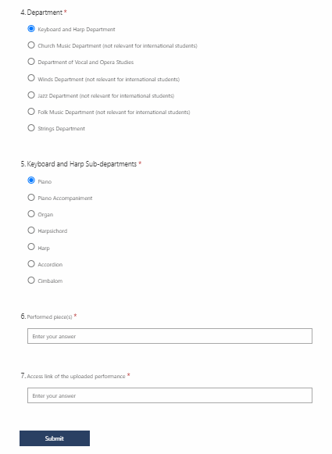
The form is available in Hungarian and English as an option in the upper right corner.
Choose your department.
Enter your name.
Enter your Neptun code.
Choose your sub-department (if applicable).
Choose your study level.
Enter the title of your performed composition.
Paste a share link copied from OneDrive.

Slide 20
Once you have completed the form, click on the "Submit" button!

Slide 21
THANK YOU FOR YOUR ATTENTION!
Consultation about recording the video is possible via the oktatastechnika@zeneakademia.hu e-mail address. Technical help for uploading the videos is possible via the itsupport.zarovizsga@zeneakademia.hu e-mail address or call the +36 1 462-4606 phone number on working days from 9 a.m. to 5 p.m. from 5 May 2021 until 25 May 2021.

